Slide 1

Machine Learning and Deep Learning Use Case
Credit Card Fraud Detection
AIDI CAPSTONE – AIDI 1003-02
FACILITATOR – REZA DIBAJ
TEAM
DEVY RATNASARI(**309)
GOPIKA SHAJI(**568)
OLUWOLE AYODELE(**448)
PRIYANKA SINGH(**824)
SAURAV BISHT(**875)

Slide 2
Top 5 Scams of 2021
Scam Type | % of Total | Median Loss
Prizes/Free Gifts | 35.23% | $795
Internet: Gen Merchandise | 19.58% | $500
Phishing/Spoofing | 17.49% | $800
Fake Check Scams | 5.59% | $2000
Friendship and Sweetheart Swindle | 3.35% | $925
Source : https://fraud.org/top-ten-scams-2021/

Slide 3

Agenda
01
What is Fraud?
04
Problem Statement & Proposed Approach
02
Top 5 Scams of 2021
05
Dataset
03
Why Fraud Detection Important?
06
Exploratory Data Analysis & Feature Engineering

Slide 4
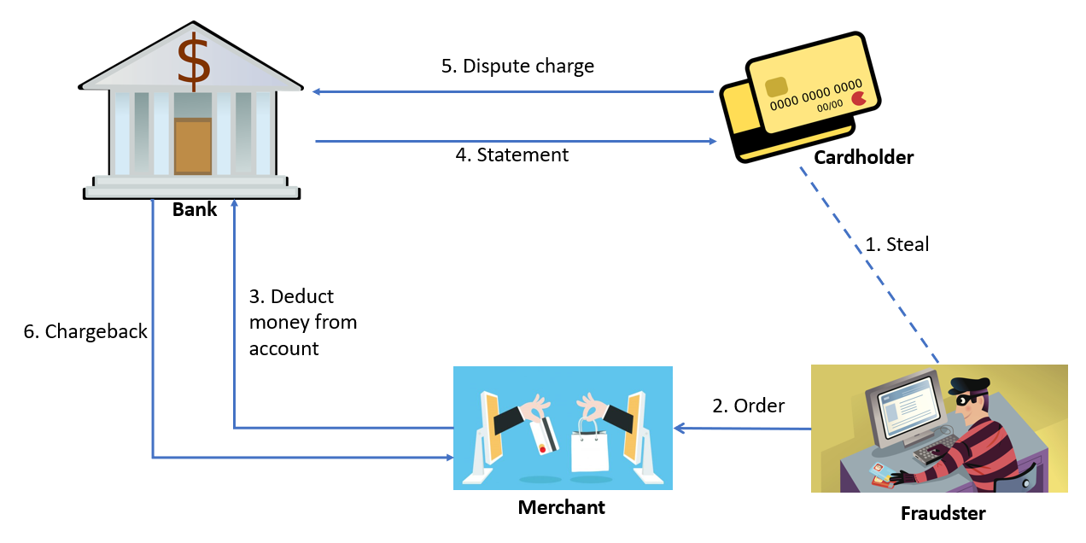
What is Fraud?

Slide 5

Why Fraud Detection Important?
23.82%
Percent growth when comparing
the last 4 months of 2020 to the
first 4 months of 2021.
149.44%
Financial Services Globally
in first 4 months of 2021
Global Increase
TransUnion Fraud Trend Q2 report
217.54%
Financial Services Canada
in first 4 months of 2021
33.66 B in 2022
Global Financial Losses
Nilson Report

Slide 6
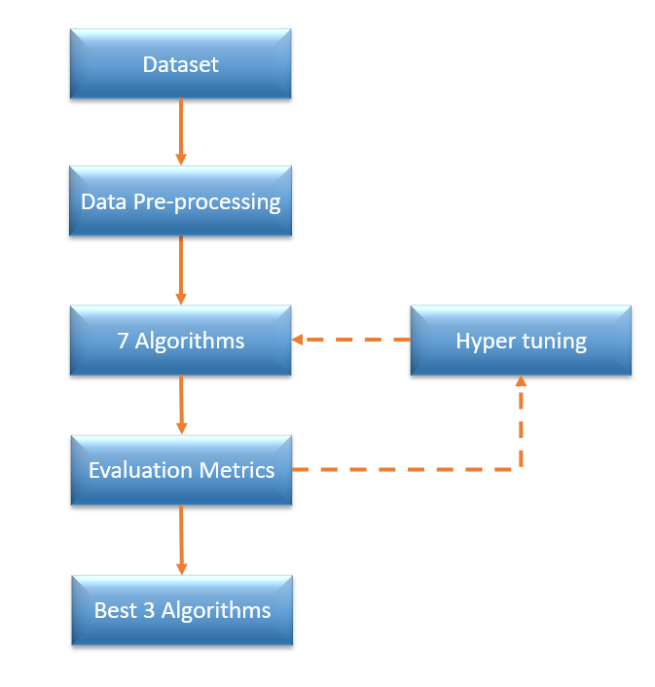


Problem Statement
Proposed Approach
Leverage machine learning algorithm categorize transaction into fraud vs non-fraud.
Non-Fraud
Fraud

Slide 7
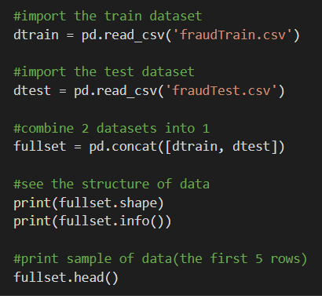
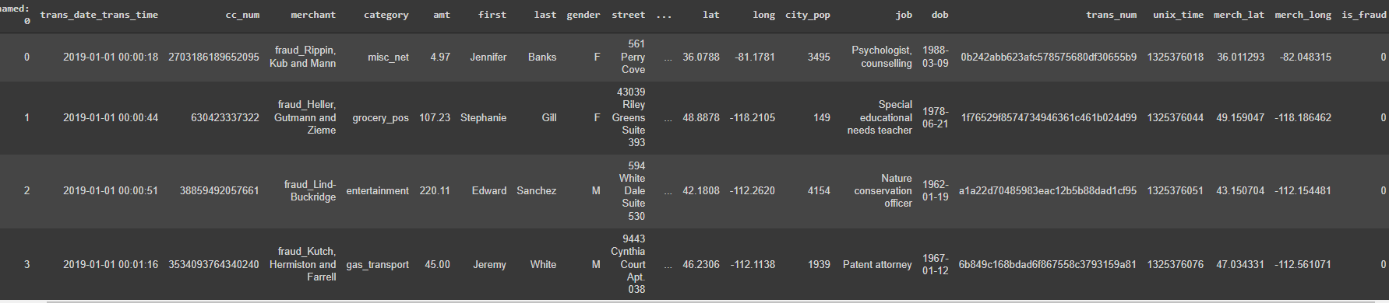
Dataset
Kaggle.com(https://www.kaggle.com/kartik2112/fraud-detection).
1.8M records and 23 columns
9651 fraud cases
11 Numerical and 12 Categorical Variables

Slide 8
Exploratory Data Analysis & Feature Engineering

Slide 9

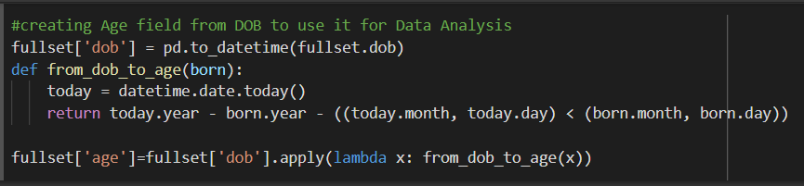
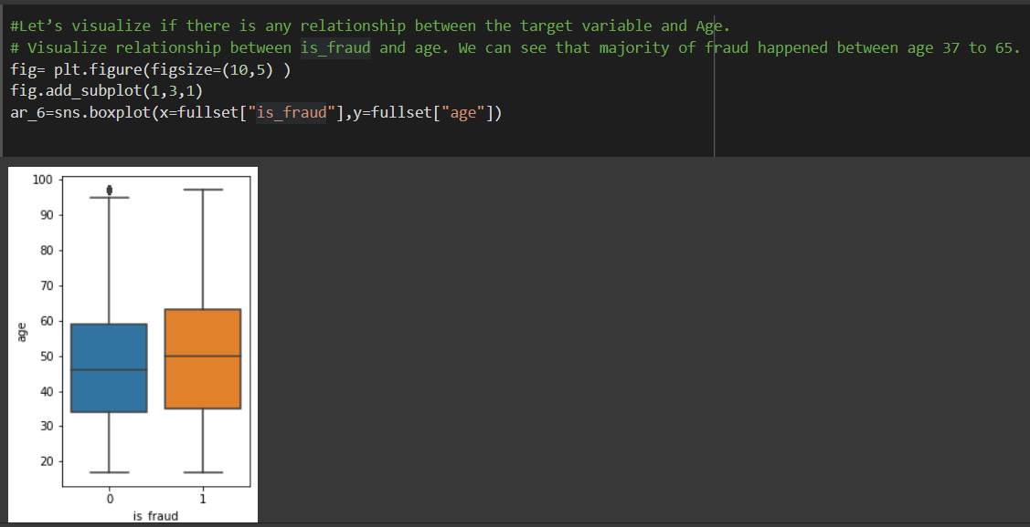
New Variable – ‘Age’
Derived from DOB
To see which age group is more vulnerable to fraudulent activities

Slide 10
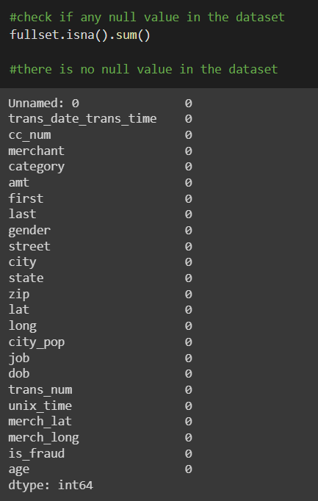
Checking for Null Values
No NULL Values
In case they exists, replace them with mean to avoid data loss

Slide 11
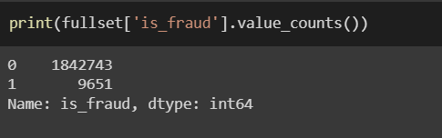
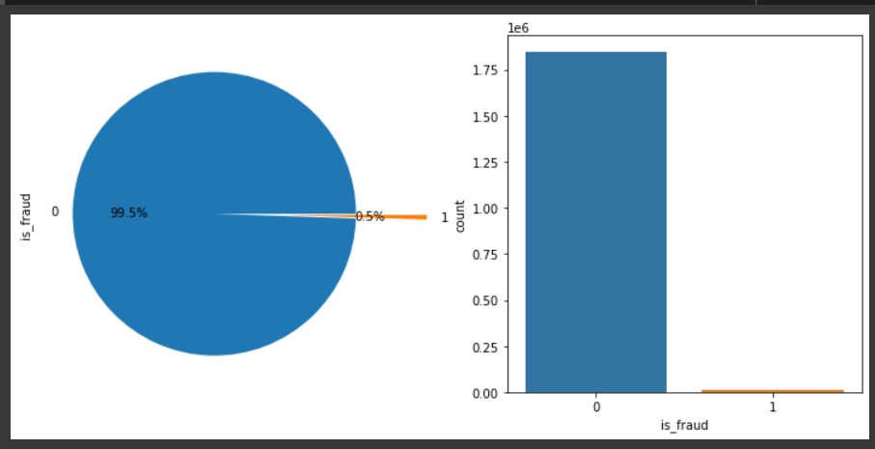
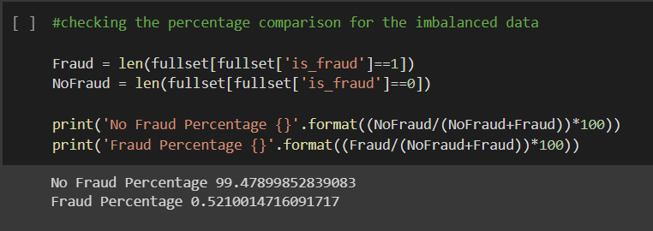
Target Variable Distribution
Imbalanced ratio is 99.47: 0.52
99% of the Observations in the dataset belong to Class 0 (Non-Fraudulent Transactions)

Slide 12
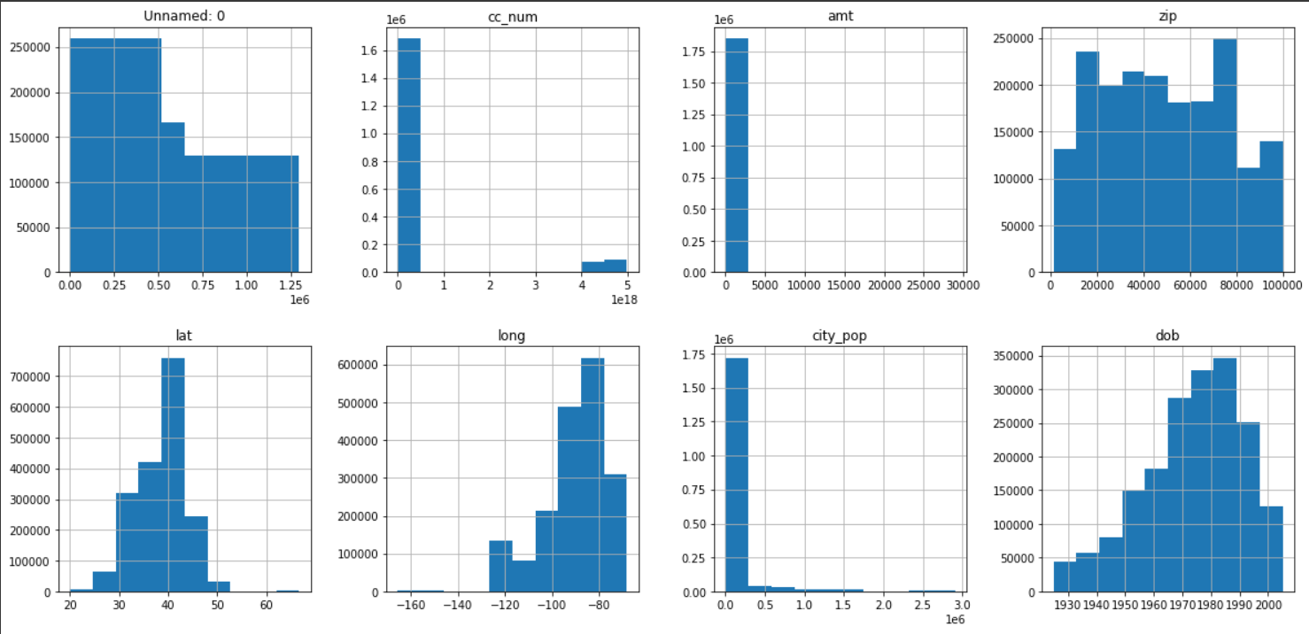
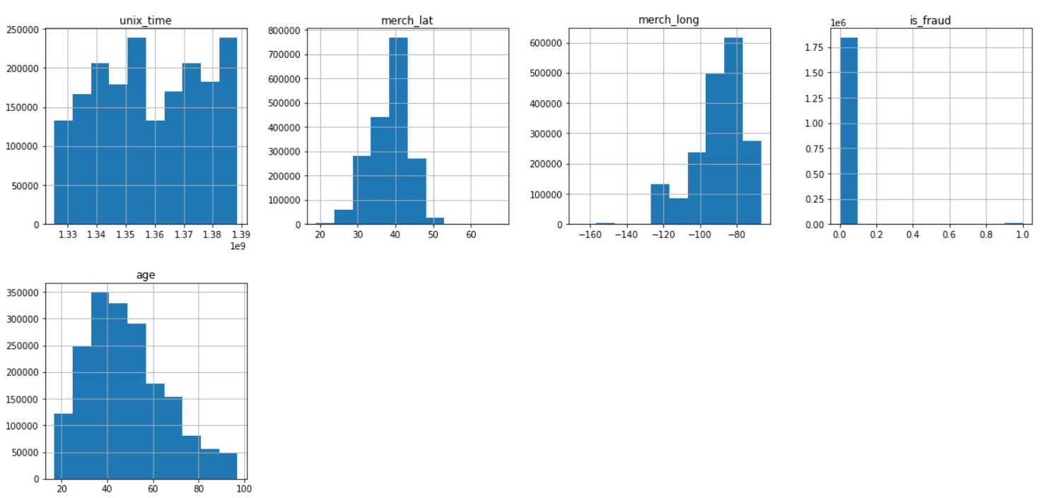
Feature Variables Data Distribution
Uniform distribution - unnamed, zip and unix_time
Normal distribution - lat, long, dob, age, merch_lat, merch_long

Slide 13
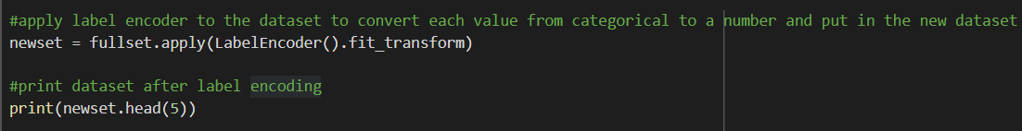
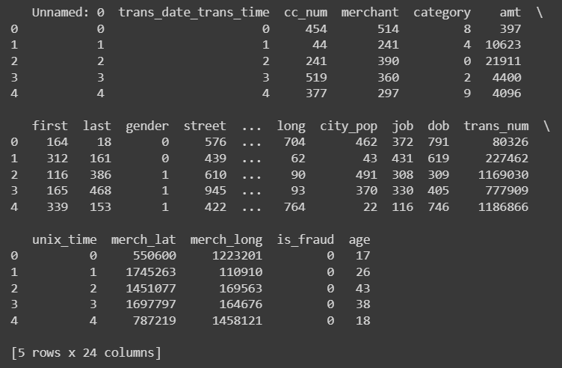
Addressing Categorical Data – Implementing Label Encoder

Slide 14
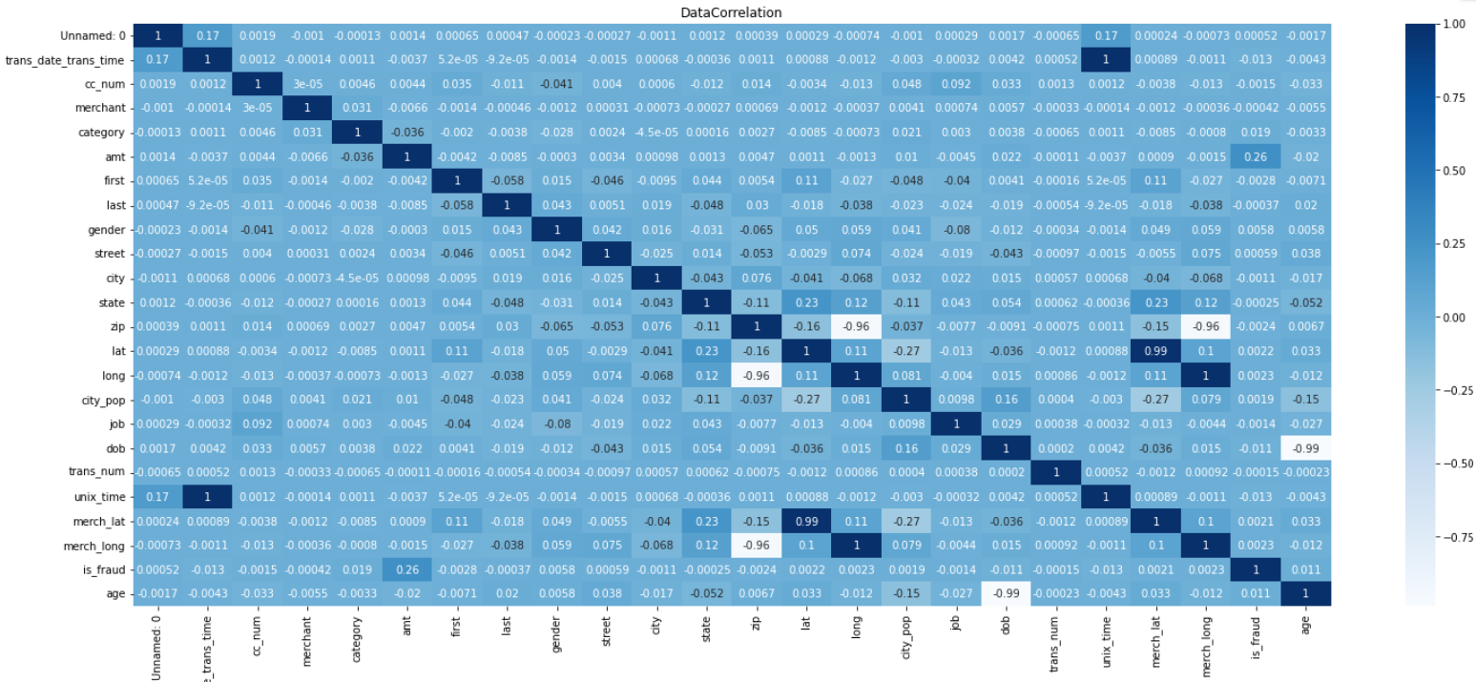
Data Correlation Using Heatmap
Correlation Threshold = 0.95

Slide 15
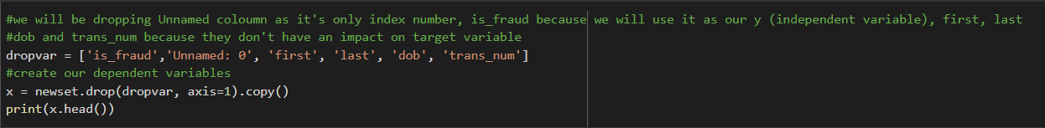
Dropping Other Unfavorable Columns
Not contributing to the analysis
Unnamed
First
Last
Trans_num

Slide 16
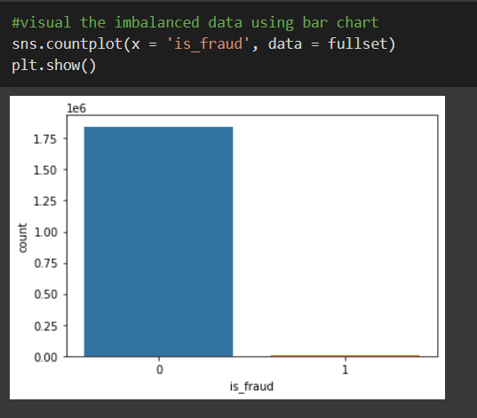
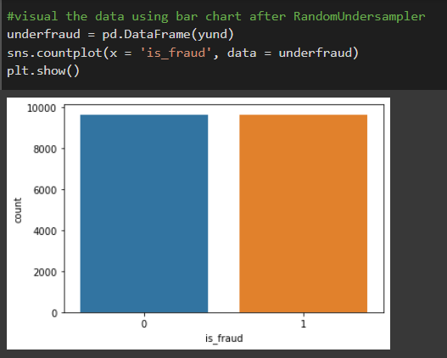
Addressing Target Label Imbalance

Slide 17
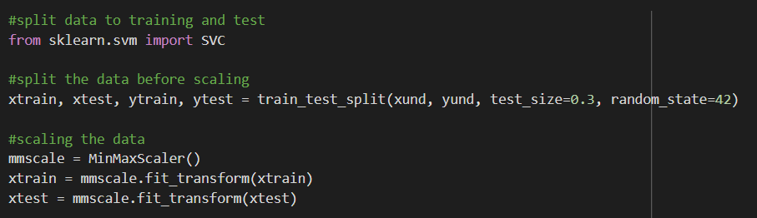
Scaling and Data Split
Fit all the data points between the range of 0 to 1

Slide 18
Algorithms Implementation & Tuning

Slide 19
Algorithms
7 machine learning algorithms
Logistic Regression
Random Forest
Decision Tree
SVM
KNN
ANN
CNN

Slide 20
Hyperparameter tuning using 10-fold cross validation
All Data
Training Data
Test Data
10 Folds
Finding Best Hyper Parameters

Slide 21
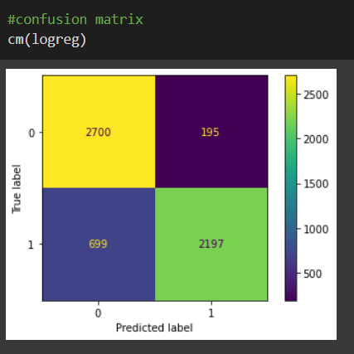
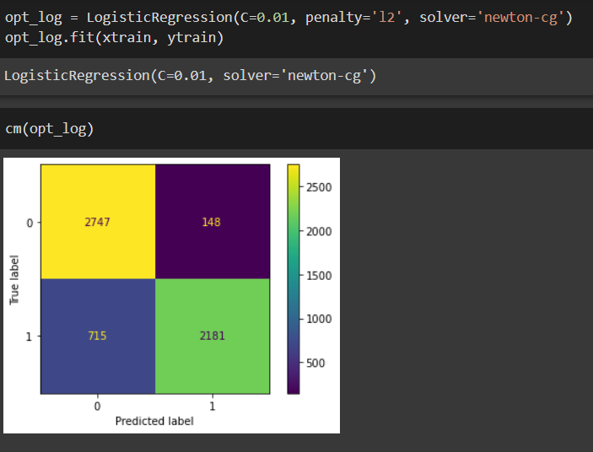
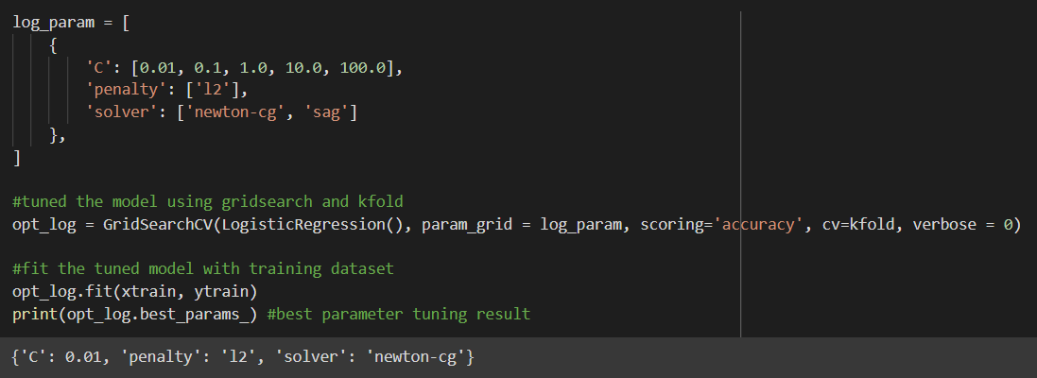
Logistic Regression

Slide 22
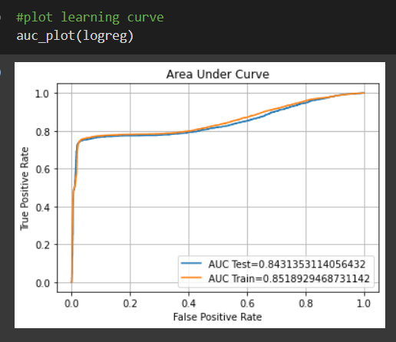
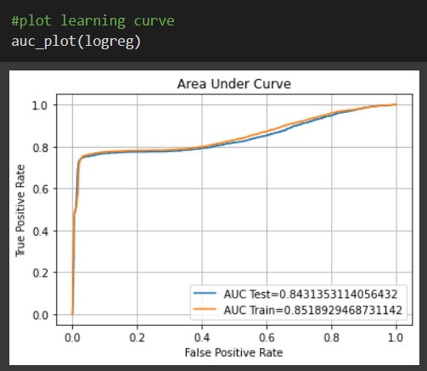
Logistic Regression

Slide 23
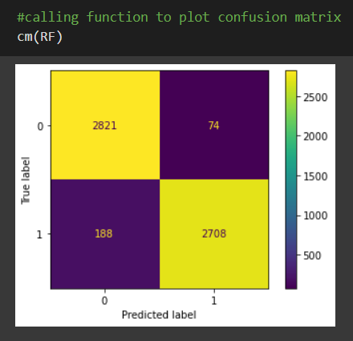
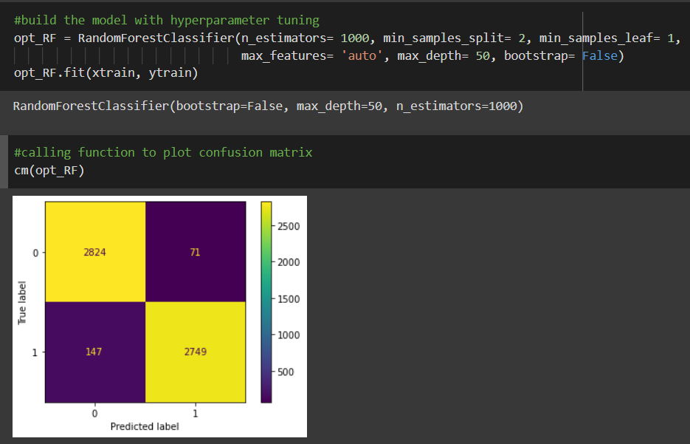
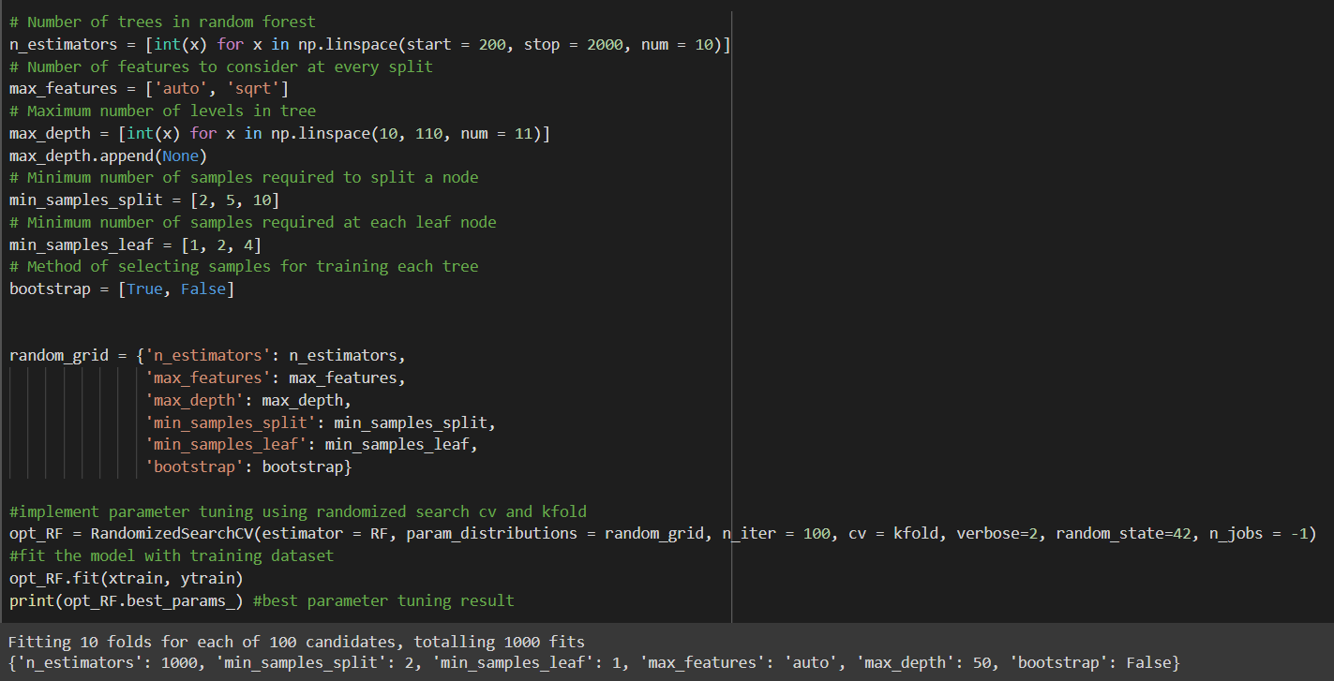
Random Forest

Slide 24
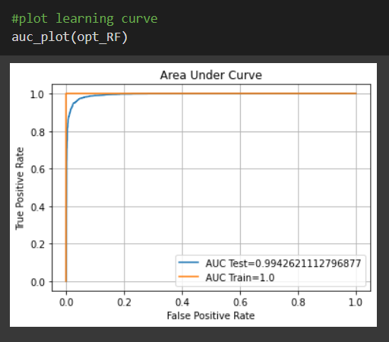
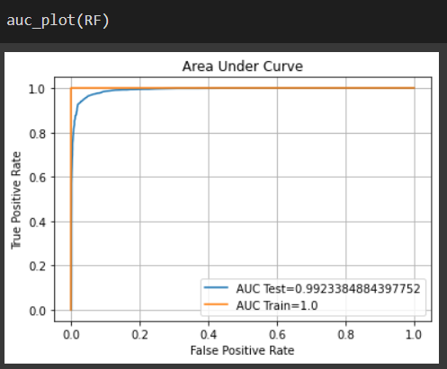
Random Forest

Slide 25
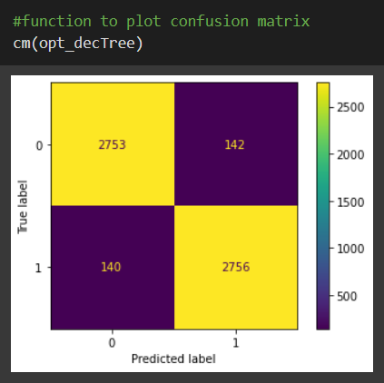
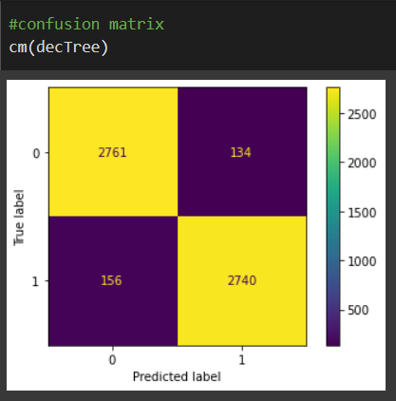
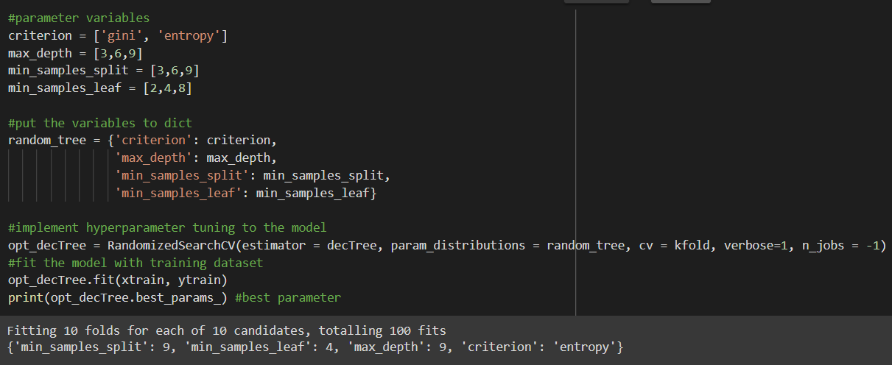
Decision Tree

Slide 26
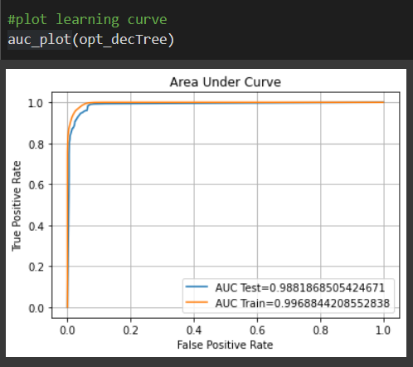
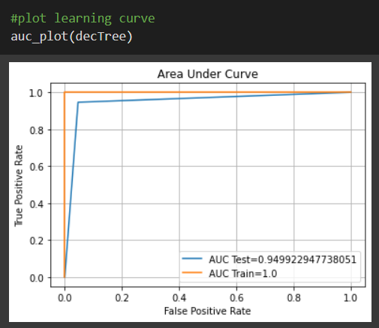
Decision Tree

Slide 27
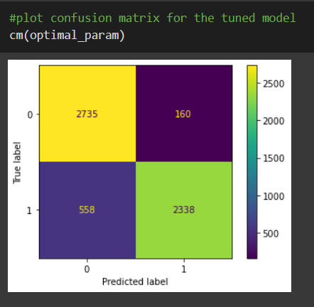
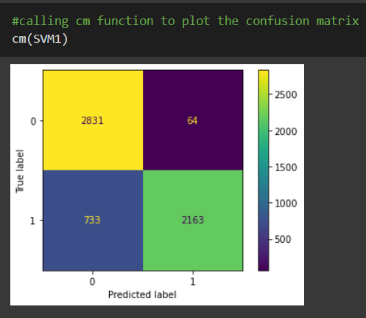
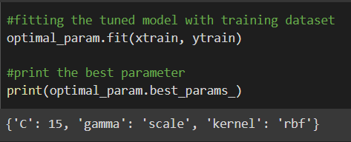
Support Vector Machines

Slide 28
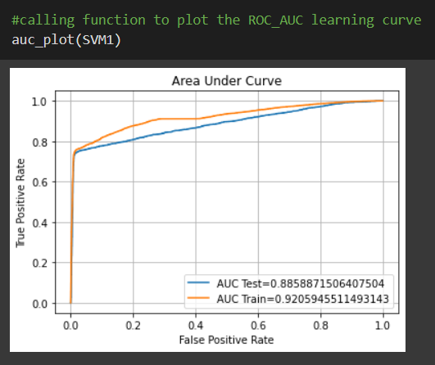
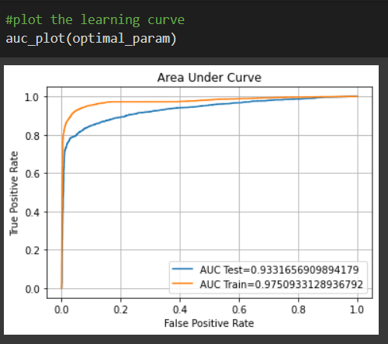
Support Vector Machines

Slide 29
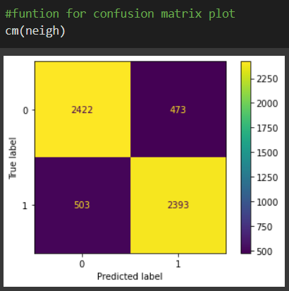
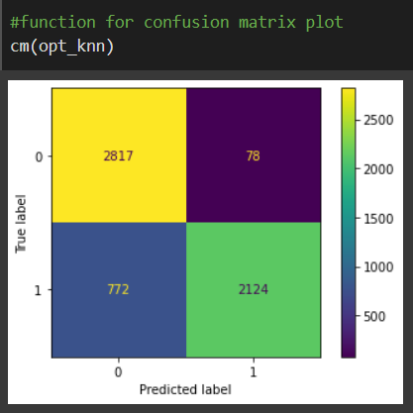
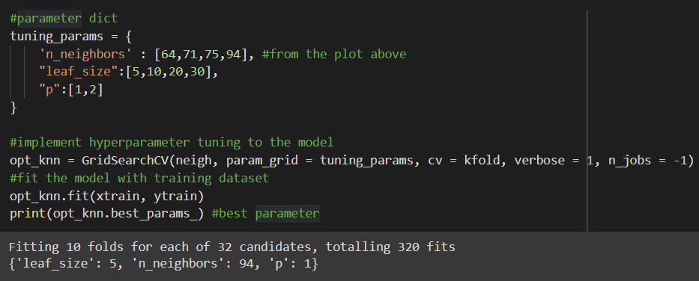
K-Nearest Neighbors

Slide 30
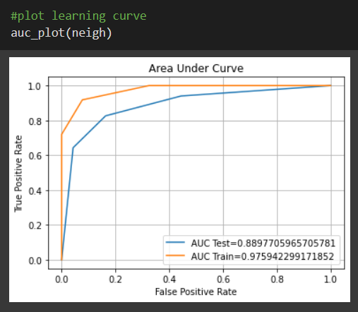
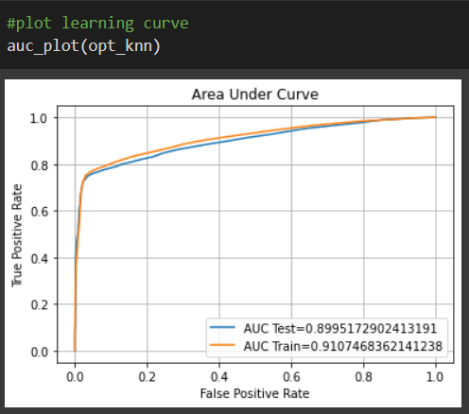
K-Nearest Neighbors

Slide 31
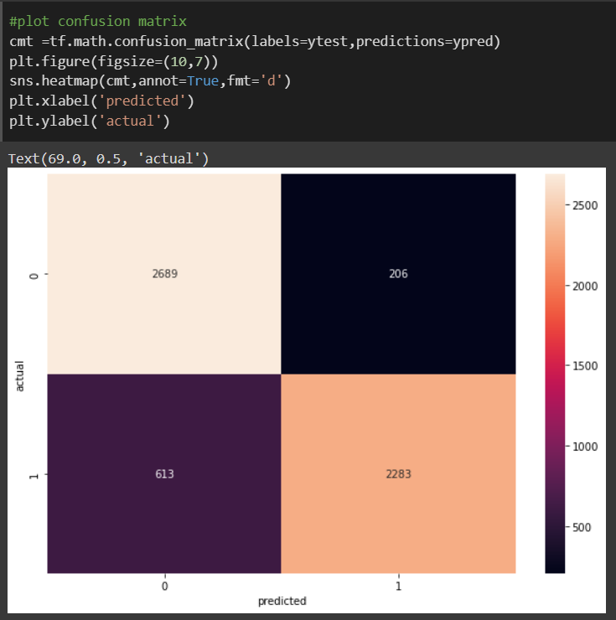
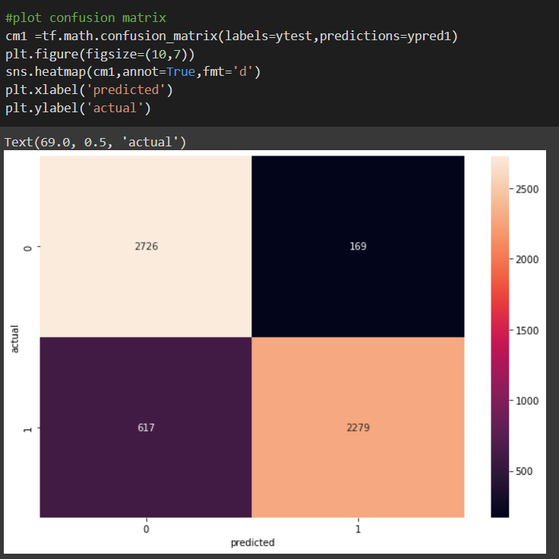
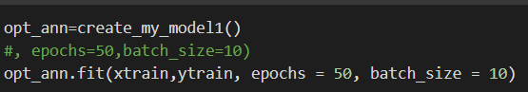
Deep learning (ANN)

Slide 32
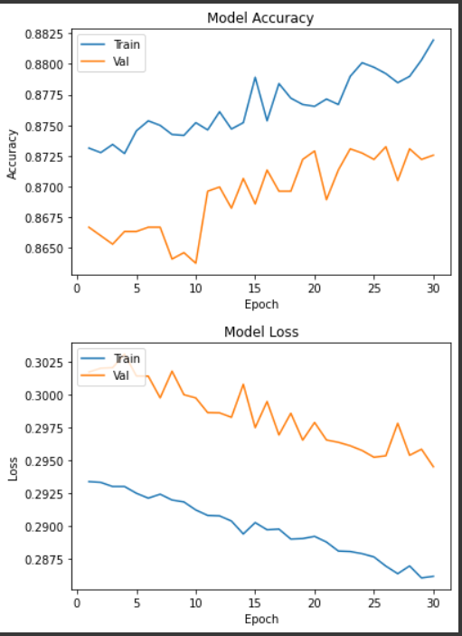
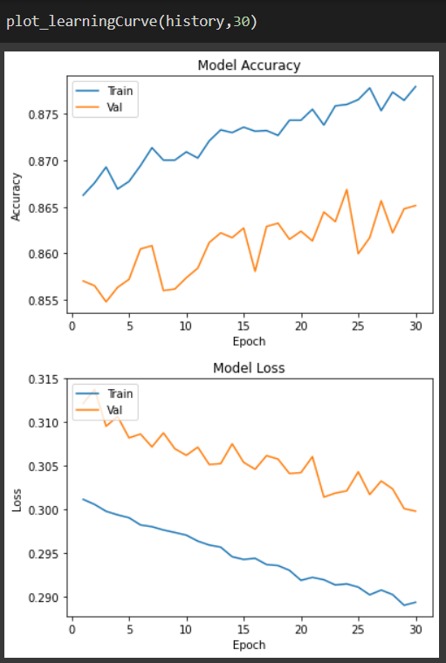
Deep learning (ANN)

Slide 33
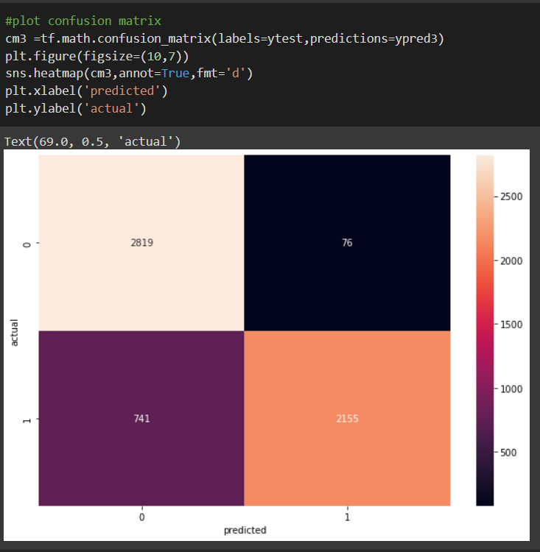


Deep learning (CNN)

Slide 34


Deep learning (CNN)

Slide 35
Model Evaluation

Slide 36

Training Vs Testing Accuracy

Slide 37

Training Vs Testing Loss

Slide 38

Precision Class 1 Vs 0

Slide 39

Recall Class 1 Vs 0

Slide 40

ROC AUC Training Vs Testing

Slide 41
Final Candidate Algorithms

Slide 42

Evaluation Matrix
Final Candidate Algorithms:
KNN
Logistic Regression
Convolutional Neural Networks
High Accuracy
Low Overfitting

